Slide 1
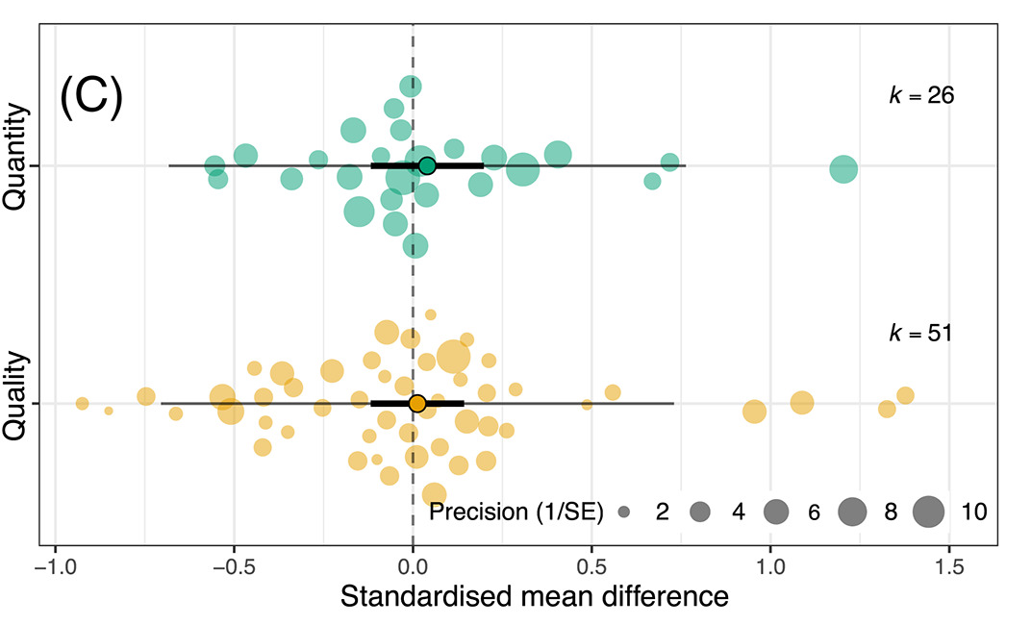
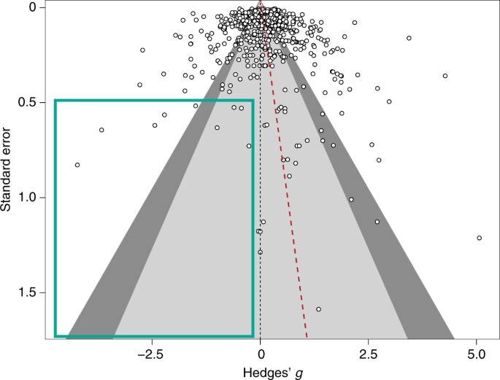
Meta-analysis in Comparative Physiology: A brief introduction to effect sizes and meta-analytic modelling
Nakagawa et al. 2021
De Boer et al. 2021
Daniel Noble, Nicholas Wu, Essie Rodgers, Patrice Pottier

Slide 2




Acknowledgements
Julia Koricheva
Wolfgang Viechtbauer
Shinichi Nakagawa
Marc Lajeunesse

Slide 3
What you want to get out of this?
Thanks for taking the survey!
Here’s what everyone wants

Slide 4
Workshop Overview
Part 1: 9:00 – 10:30
What is meta-analysis and why should we use it?
Effect size and sampling variance: the key data for meta-analysis
What are effect sizes?
What types are out there and when to use?
Standardizing effect estimates – nuisance heterogeneity
Interpreting effect sizes and transformations
Assumptions, limitations, and common challenges
Part 2: 11:00 – 12:30
Meta-analytic modelling
Fixed and random effect meta-analyses
Multi-level meta-analytic models (MLMA): The main types in comparative physiology
Non-independence – phylogeny, study, species, shared controls
Robust variance estimation
Sensitivity analyses
Meta-regression and heterogeneity
Interpreting and reporting meta-analytic model output
Publication bias
Time-lag, reporting bias
Detecting and correcting
Part 3: 14:45 – 16:00
Help (advice) with your own meta-analysis! (if you need it)

Slide 5
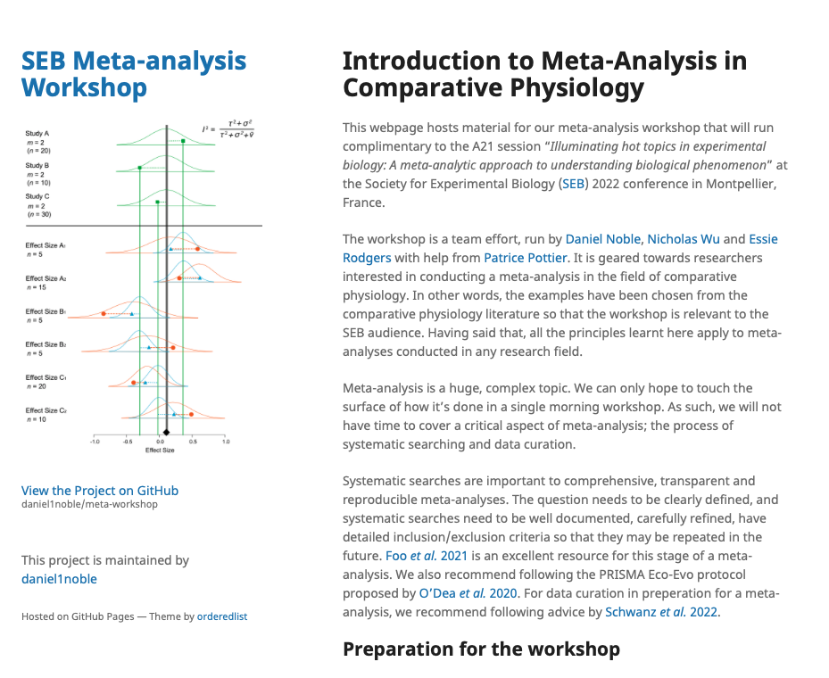
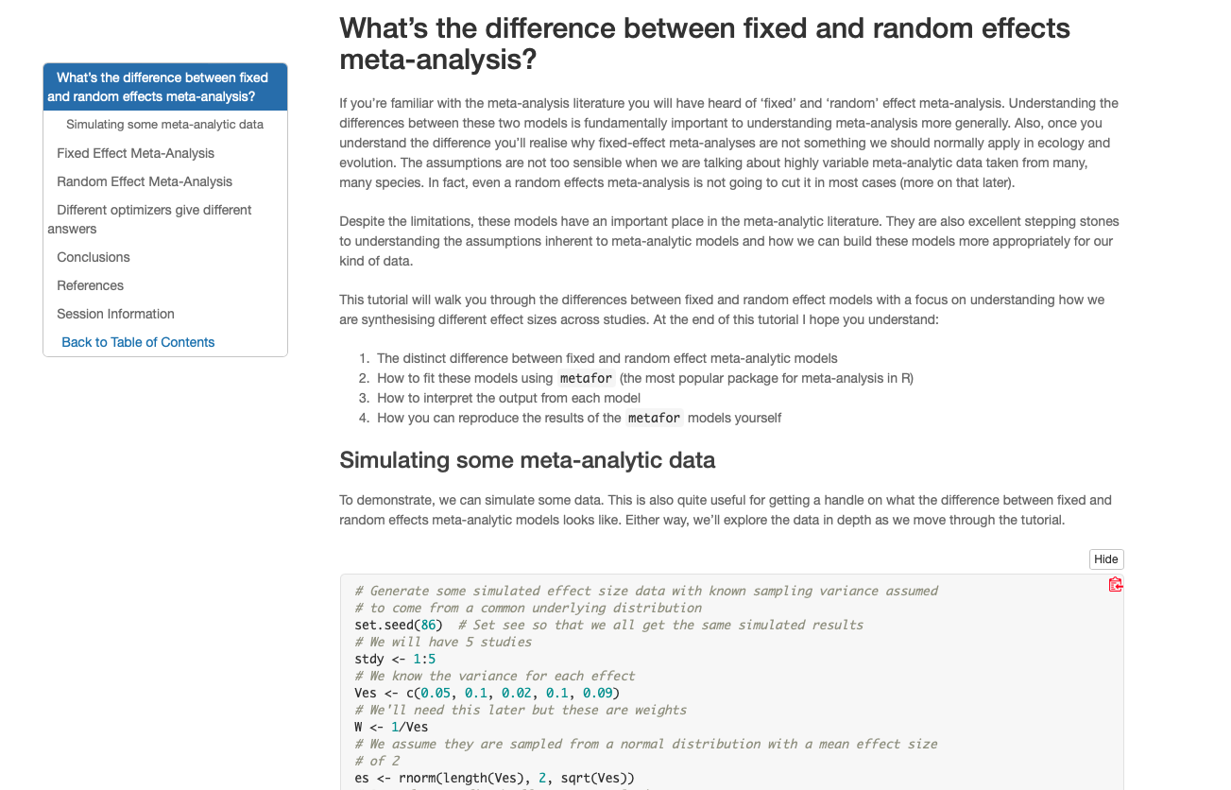
We have a webpage!
https://daniel1noble.github.io/meta-workshop/

Slide 6


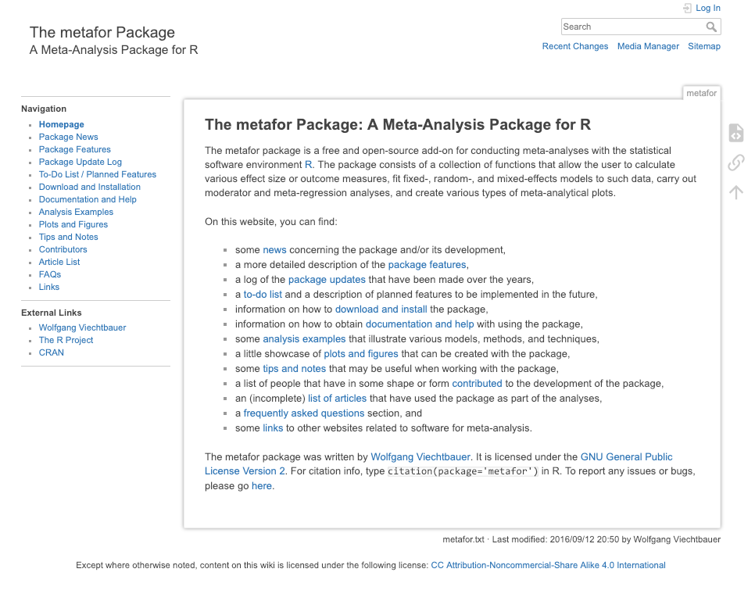
What we’ll use to code and analyze

Slide 7
https://wviechtb.github.io/metafor/articles/pkgdown/diagram.png

Slide 8
What is a meta-analysis?
Statistical methods and techniques for aggregating, summarizing, and drawing inferences from collections of studies
Part of a Systematic Review
Collate empirical evidence that fits pre-specified eligibility criteria in order to answer a specific research question
Explicit, systematic methods are selected with a view to minimize bias,
Provides more reliable findings from which conclusions can be drawn and decisions made

Slide 9
Why do we want to do meta-analysis?
Meta-analysis increases power and precision to estimate effects
Individual studies are (often) underpowered (Jennions & Møller, 2003)
High sampling variability can exaggerate effects; don’t put too much faith in a single study.
Establishes generalities
Explores differences between studies and why they exist
Generates new hypotheses
Helps settle controversies from conflicting empirical studies
Can identify potential publication biases
Identify knowledge gaps to provide guidance for future empirical studies

Slide 10
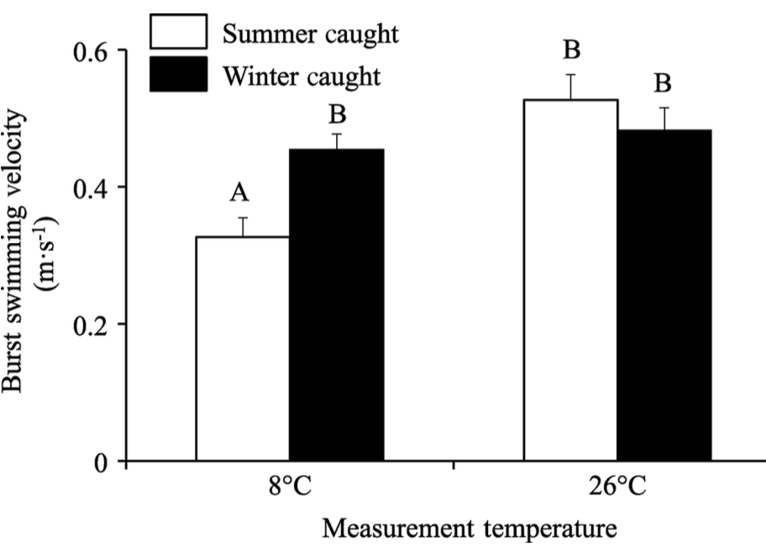
But what does this all mean?
Assume we want to conduct an experiment measuring burst swimming speed at two temperatures using some fish species
We take a sample of 20 fish acclimated to summer temperatures and measure burst swim speed for 10 fish at 8ºC and another 10 fish at 26ºC.
What is the difference in burst swimming speed between winter acclimated fish at the two measurement temperatures?

Slide 11
Our first experiment…..in silico
# Speed at 8 C treatment trt_8C <- rnorm(10, 0.4, 0.5) # Speed at 26 C treatment trt_26C <- rnorm(10, 0.6, 0.2) # What's the difference, i.e., effect size, between treatments? mean(trt_26C - trt_8C)
## [1] 0.1188703
t.test(trt_26C, trt_8C)
## ## Welch Two Sample t-test ## ## data: trt_26C and trt_8C ## t = 0.82071, df = 11.497, p-value = 0.4285 ## alternative hypothesis: true difference in means is not equal to 0 ## 95 percent confidence interval: ## -0.1982425 0.4359832 ## sample estimates: ## mean of x mean of y ## 0.5334862 0.4146159

Slide 12
Our second experiment….
# Speed at 8 C treatment trt_8C <- rnorm(10, 0.4, 0.5) # Speed at 26 C treatment trt_26C <- rnorm(10, 0.6, 0.2) # What's the difference, i.e., effect size, between treatments? mean(trt_26C - trt_8C)
## [1] 0.2729652
t.test(trt_26C, trt_8C)
## ## Welch Two Sample t-test ## ## data: trt_26C and trt_8C ## t = 1.6346, df = 16.942, p-value = 0.1206 ## alternative hypothesis: true difference in means is not equal to 0 ## 95 percent confidence interval: ## -0.0794437 0.6253740 ## sample estimates: ## mean of x mean of y ## 0.6630395 0.3900743

Slide 13
Our third experiment….woohoo!...wait, what?
# Speed at 8 C treatment trt_8C <- rnorm(10, 0.4, 0.5) # Speed at 26 C treatment trt_26C <- rnorm(10, 0.6, 0.2) # What's the difference, i.e., effect size, between treatments? mean(trt_26C - trt_8C)
## [1] 0.4113465
t.test(trt_26C, trt_8C)
## ## Welch Two Sample t-test ## ## data: trt_26C and trt_8C ## t = 2.525, df = 13.776, p-value = 0.0245 ## alternative hypothesis: true difference in means is not equal to 0 ## 95 percent confidence interval: ## 0.06140173 0.76129118 ## sample estimates: ## mean of x mean of y ## 0.5352081 0.1238616

Slide 14
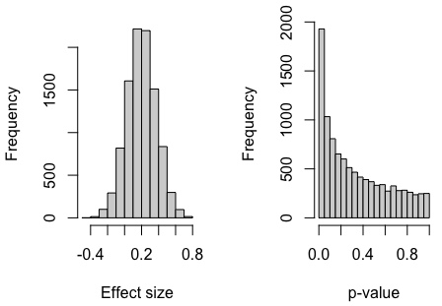
We got money to repeat experiments thousands of times…

Slide 15
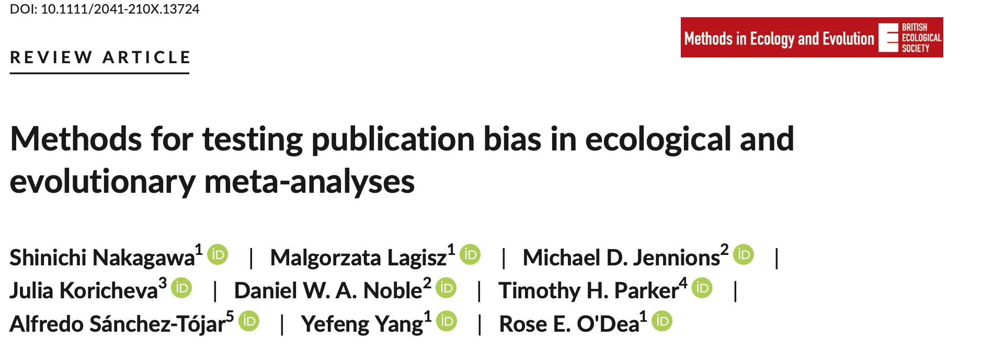
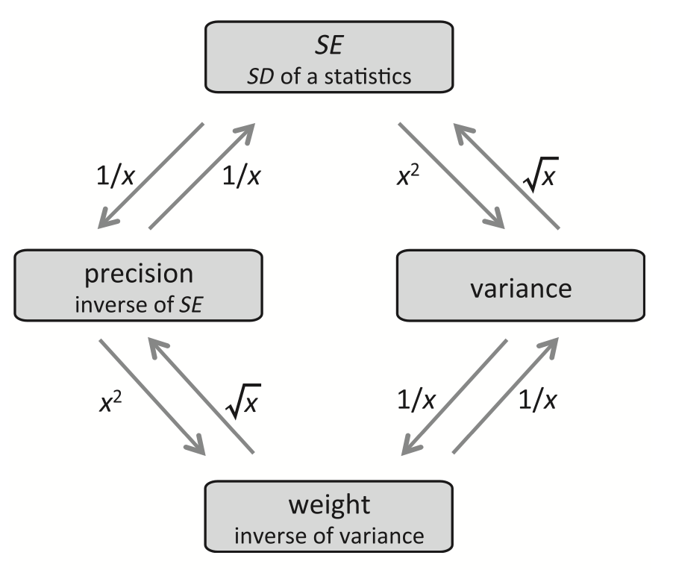
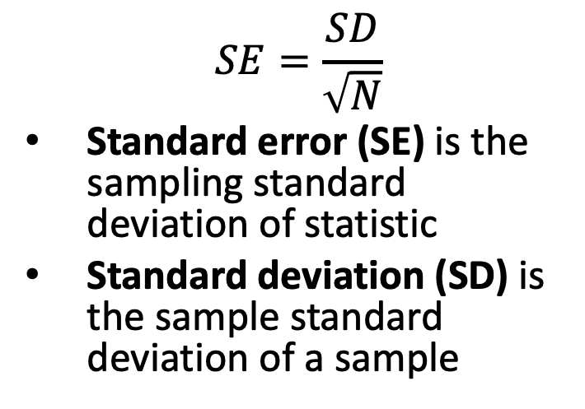
Standard error, standard deviation precision, weights
$$SE=\frac{SD}{\sqrt{N}}$$
Standard error (SE) is the sampling standard deviation of statistic
Standard deviation (SD) is the sample standard deviation of a sample

Slide 16
Meaning of standard error…
t.test(trt_26C, trt_8C)
Welch Two Sample t-test
data: trt_26C and trt_8C
t = 2.8436, df = 14.986, p-value = 0.01233
alternative hypothesis: true difference in means is not equal to 0
95 percent confidence interval:
0.07966499 0.55667951
sample estimates:
mean of x mean of y
0.6184471 0.3002748
# Calculate SE from t.test
SE <- (0.55667951 - 0.07966499)/3.92
# [1] 0.1216874
# Calculate SE from our simulation

Slide 17
But what is an ‘effect size’?
A measure of the magnitude (and direction) of difference, association or central tendency that is comparable across studies
Core unit of analysis in meta-analysis

Slide 18
“Effect size” value
e.g. 30% difference, a slope of 1.2, r = 0.2
“Effect size” statistic (or effect statistic)
e.g. d, r and odds ratio
The biological (practical/clinical) importance of an “effect-size” value
e.g. r = 0.5 is a ”strong” correlation
e.g. a 5% increase in death is not negligible

